Slide 1
Traversing a List #2
A supplemental lesson for AP CSP

Slide 2
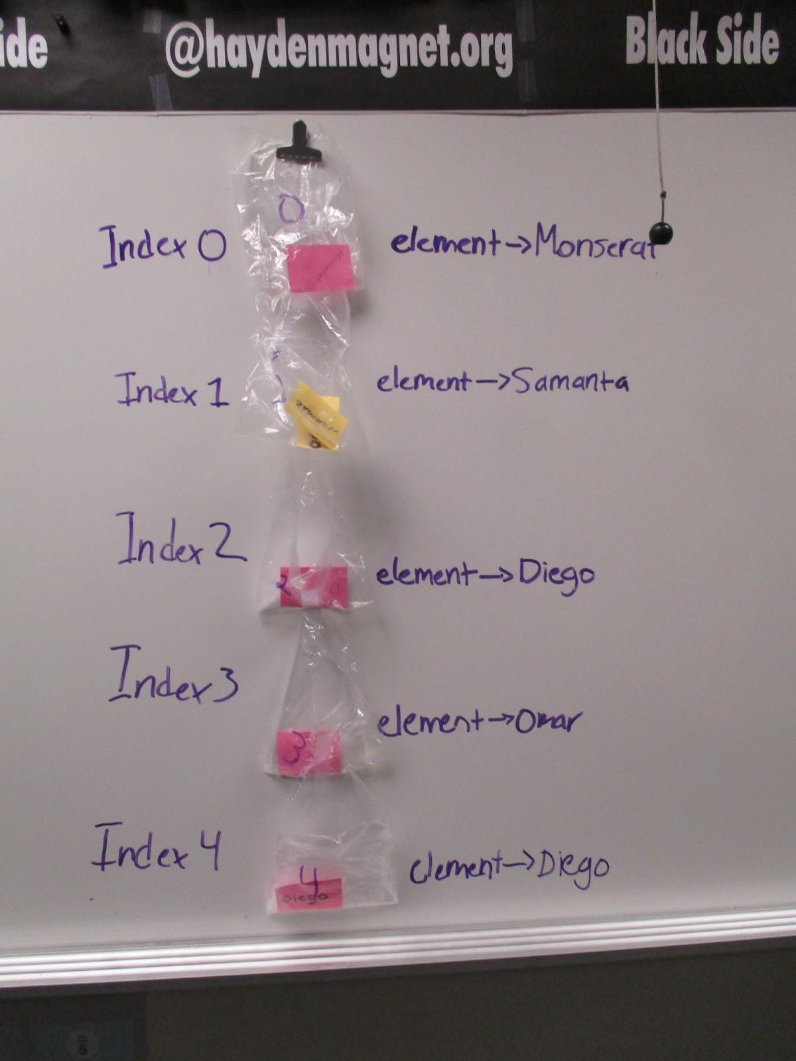
Warm-up
In the last lesson, you practiced using for loops to traverse a list.
What do you remember about for loops?
What do you remember about traversing a list?

Slide 3
For loops
In the last lesson, you used a for loop to traverse a list.
For loops can be used for all kinds of things, not just traversing a list.
Let’s look at another way to use a for loop.
In CodeSpace, open Answer_Bot_traversals (from the last lesson).
Use the sandbox.

Slide 4
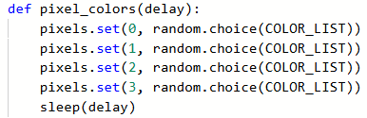
For loops
Look at the pixel_colors() function.
It calls pixels.set() four times.
The only difference in the four function calls is the pixel.
Modify the function to use a for loop to accomplish the task.
Use the loop control variable for the pixel to light.

Slide 5

For loops
Does your loop look similar to this:
The loop control variable can be called any descriptive name.
Use the loop control variable as an argument in the function call.

Slide 6
For loops
Compare the two functions.
Moving forward, when a program requires iteration
(a loop) see if you can use a for loop.
Before
After

Slide 7
Traversing a list
Traversing means to travel, or traverse, through a list one element at a time in order.
To traverse a list you use a for loop to:
Start with the first index (0) and access that item.
Continue accessing each item in order until the last index (length of list - 1) is reached.
This technique is sequencing.

Slide 8
Traversing a list
Traversing a list can be very useful in many ways.
Some reasons are:
Display all items in a list, one at a time, like a slideshow.
Looking through a list to see if a particular value is an item in the list.
Create a sub-list from the complete list, like all numbers less than 10.
Let’s look at another program that can traverse a list.

Slide 9
Traversing a List: Example #4
This program will traverse multiple lists.
In CodeSpace, open Pixels1_parameters.
Use the sandbox.
Go to File → Save As… and rename the program Pixels1_traversals
First, change the turn_pixels() function to use a loop instead of repeating the pixels.set() call four times.
Also, take out delay as a parameter.

Slide 10
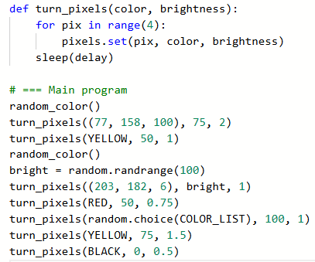
Traversing a List: Example #4
Look at your Main Program.
If you have function calls to random_color(), you can delete them for now.
This program will only use turn_pixels().

Slide 11
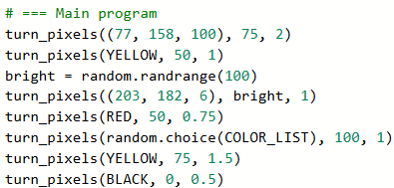
Traversing a List: Example #4
Your Main Program will be different, but similar, to this.
The Main Program calls the same turn_pixels() function several times.
Just like the turn_pixels() function was able to use a for loop for the function calls, you can use a for loop in the main program for the turn_pixels() function calls.

Slide 12

Traversing a List: Example #4
You will need some lists!
Create a list for each color, adding the items in the order you want them to display.
In the example below, the list looks like this:

Slide 13
Traversing a List: Example #4
Use the first argument of each function call as the items in the list.
An item can be an RGB tuple, pre-defined color, random choice, etc.

Slide 14
Traversing a List: Example #4
Create a second list for the brightness.
Use the second argument for the items in the list.
You will not do one for the delay (although you could).
Each list should be the same length.

Slide 15

Traversing a List: Example #4
Use a for loop in the main program to traverse the lists.
You will use only two arguments. The delay will remain the same throughout the program.

Slide 16
Traversing a List: Example #4
Your program is much shorter now!
You used procedural abstraction and data abstraction to manage complexity.
The turn_pixel() function with parameters is procedural abstraction.
It allows you to use the same function for any color and brightness without duplicating code, and you can call the function as many times as you want.
The lists are data abstraction.
The lists allow you to easily modify the data (add, move, change, etc.) and you will not have to change the code at all!

Slide 17
Traversing a List: Example #5
The Pixels1_traversals program uses two lists. Can you combine the information from both lists into one?
A 2D list is a list of lists.
It is also known as a matrix or table.
Give it a try!
Go to File → Save As… and rename your project Pixels1_matrix

Slide 18
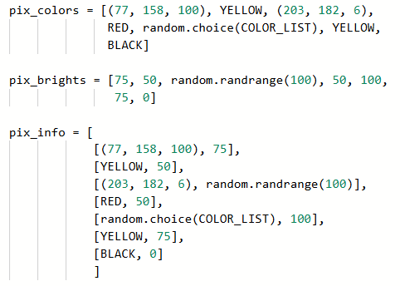
Traversing a List: Example #5
Start a new list.
Each element in the list will be another list:
[color, brightness]
The new list will be a list of lists!
Each element is listed on its own line so you can clearly see the 7 items. Each one is a list.

Slide 19
Traversing a List: Example #5
Delete the first two lists, so you only have one.

Slide 20

Traversing a List: Example #5
Modify the for loop to access the separate items in each list of the list.

Slide 21
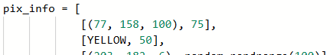
Traversing a List: Example #5
Let’s look closely at the function call’s arguments.
  pix_info[index] is each element in the list.
  Each element is a list with 2 items.
  The first item is [0] – the color
  The second item is [1] – the brightness
Index 0
[0][0] [0][1]

Slide 22
Traversing a List Summary
You now have several ways to traverse a list in a CodeX program:
Traverse a single list using a specialized for loop
Traverse multiple lists using a for loop and index
Repeatedly traverse multiple lists using a for loop
Use these programs as your own personal library. When you need to use a list, access an element, or traverse a list, you can refer to this code, if needed.

Slide 23
Traversing a List: Challenge #1
Return to either Pixels1_traversals or Pixels1_matrix.
Add another list, or element to the lists, for delay.
The turn_pixels() function will have three parameters:
turn_pixels(color, brightness, delay)

Slide 24
Traversing a List: Challenge #2
Open one of your remix projects.
Create or modify a function so that it has at least one parameter.
Create at least one list.
Access the elements in the list either randomly, or through traversal.

Slide 25
Wrap Up
Submit the completed programs to your teacher.
Complete the wrap-up questions in the activity guide.

